Slide 1
Data Camp Data Analyst Sales Product Case Study
1 . Introduction
This report aims to analyze the effectiveness of different sales methods used for a new line of office stationery products launched by Pens and Printers. The company tested three sales approaches: Email, Call, and Email and Call.

Slide 2
Sales Product Case Study
The goal of this analysis is to answer the following questions posed by the sales team:
How many customers used each sales approach?
What does the spread of revenue look like overall and for each method?
Is there a difference in revenue trends over time for each sales method?
Which sales method is most effective, and what should be recommended for future strategies?

Slide 3
Sales Product Case Study
2. Data Validation and Cleaning
The dataset (product_sales_sample.csv) was initially loaded and validated. Here are the key steps taken:
Data Loading: The dataset was loaded using Python for validation and inspection.
Validation: We checked for missing values, incorrect data types, and duplicates.
No missing values were found.
The data types were correctly assigned (e.g., week as integer, sales_method as categorical).
Data Cleaning: We removed any duplicate entries to ensure data integrity.
Data Preparation: The cleaned data was saved as cleaned_product_sales.csv for further analysis in Power BI.

Slide 4
Sales Product Case Study
3. Exploratory Data Analysis (Python)
We conducted initial exploratory analysis using Python to understand the distribution of the data and identify trends.
Key Findings:
Customer Count by Sales Method:
We created a bar chart showing the number of customers for each sales method.
The Email and Call method had the highest customer count, followed by Email and Call.
Revenue Distribution:
We analyzed the overall revenue distribution using a histogram.

Slide 5
Sales Product Case Study
Revenue values ranged from $50 to $1000, with a peak around the $400-$600 range
Weekly Revenue Trend:
A line chart was plotted to observe revenue trends over time for each sales method.
The Email and Call method showed a slight increase in revenue over the weeks, suggesting its effectiveness in maintaining customer engagement.
These visualizations provided initial insights into the effectiveness of the sales methods.

Slide 6
Sales Product Case Study
4. Overview of the Dashboard
The dashboard covers:
Revenue distribution across different sales methods.
Customer engagement metrics.
Weekly revenue trends.
Key performance indicators (KPIs) like total revenue, total customers, total products sold, and average revenue per method.
With this, we can get a holistic view of our sales performance.

Slide 7
Sales Product Case Study
2. Revenue Distribution by Sales Method
As shown in the first bar chart, we have analyzed the revenue generated by each sales method:
Email, Call, and a combination of Email and Call.
The "Email and Call" method clearly stands out as the top performer, generating the highest revenue among the three.
This indicates that combining email outreach with follow-up calls is the most effective strategy for driving revenue.
Recommendation: We should continue to leverage this multi-channel approach as it leads to higher customer engagement and better sales outcomes.

Slide 8
Sales Product Case Study
3. Sales Method Distribution (Pie Chart)
The pie chart illustrates the proportion of customers reached through each sales method:
37% of customers preferred using the "Call" method.
32.4% responded to the combined method of "Email and Call."
30.6% used the "Email" method alone.
Although the "Call" method has the largest share, the close performance of the "Email and Call" method suggests a growing preference for integrated communication.

Slide 9
Sales Product Case Study
Insight: The diversity in customer preferences highlights the importance of offering multiple options for contact, catering to different customer needs.
4. Number of Customers per Sales Method
The next bar chart showcases the number of customers acquired through each sales method.
The distribution is quite balanced, with the "Email" method slightly ahead.
This balance indicates that our strategies are reaching a broad audience effectively, and each method has its unique value in customer acquisition.
Action Point: We should continue using all three methods while focusing on refining and tailoring our approach based on customer preferences.

Slide 10
Sales Product Case Study
5. Weekly Revenue Trends by Sales Method
Moving on to the line chart, we can observe weekly revenue trends for each sales method:
There are consistent fluctuations, but the combined method (Email and Call) shows more pronounced peaks.
This suggests that using a multi-channel strategy is effective, especially during key weeks, driving higher revenue than using email or calls alone.
Insight: By monitoring these trends closely, we can identify the best times for launching campaigns and increase our focus during high-performing weeks.

Slide 11
Sales Product Case Study
6. Key Metrics (KPIs)
We have highlighted some crucial KPIs to summarize our overall performance:
Total Revenue: ₹267.8k, indicating strong financial results.
Total Customers: 500, showing good engagement and reach across all sales methods.
Total Products Sold: 5K, demonstrating a high volume of sales and product demand.
Average Revenue per Method: ₹535.60, suggesting efficiency in each sales interaction

Slide 12
Sales Product Case Study
efficiency, helping us assess the effectiveness of our strategies.
5. Conclusion and Recommendations
To conclude:
The combined sales method ("Email and Call") has emerged as the top performer in both revenue generation and customer engagement.
We should continue to emphasize this strategy while optimizing individual methods based on customer feedback.
Regular analysis of weekly trends will help us fine-tune our approach and capitalize on high-performing periods.

Slide 13
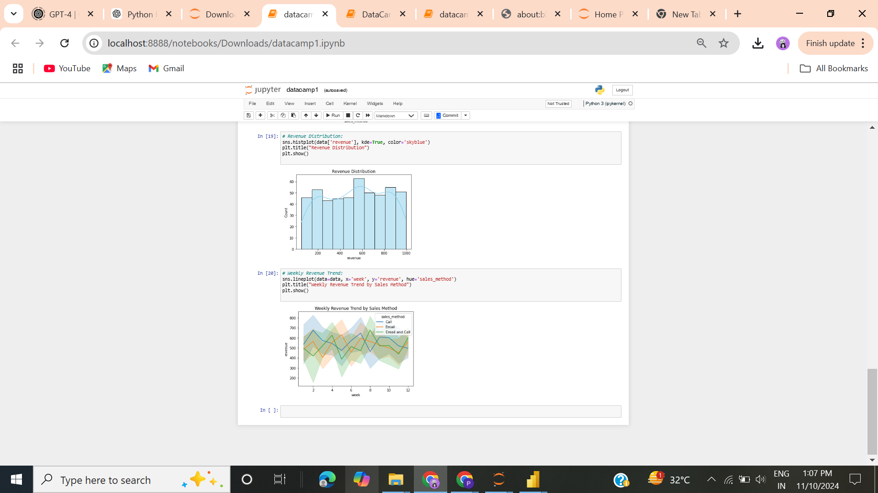
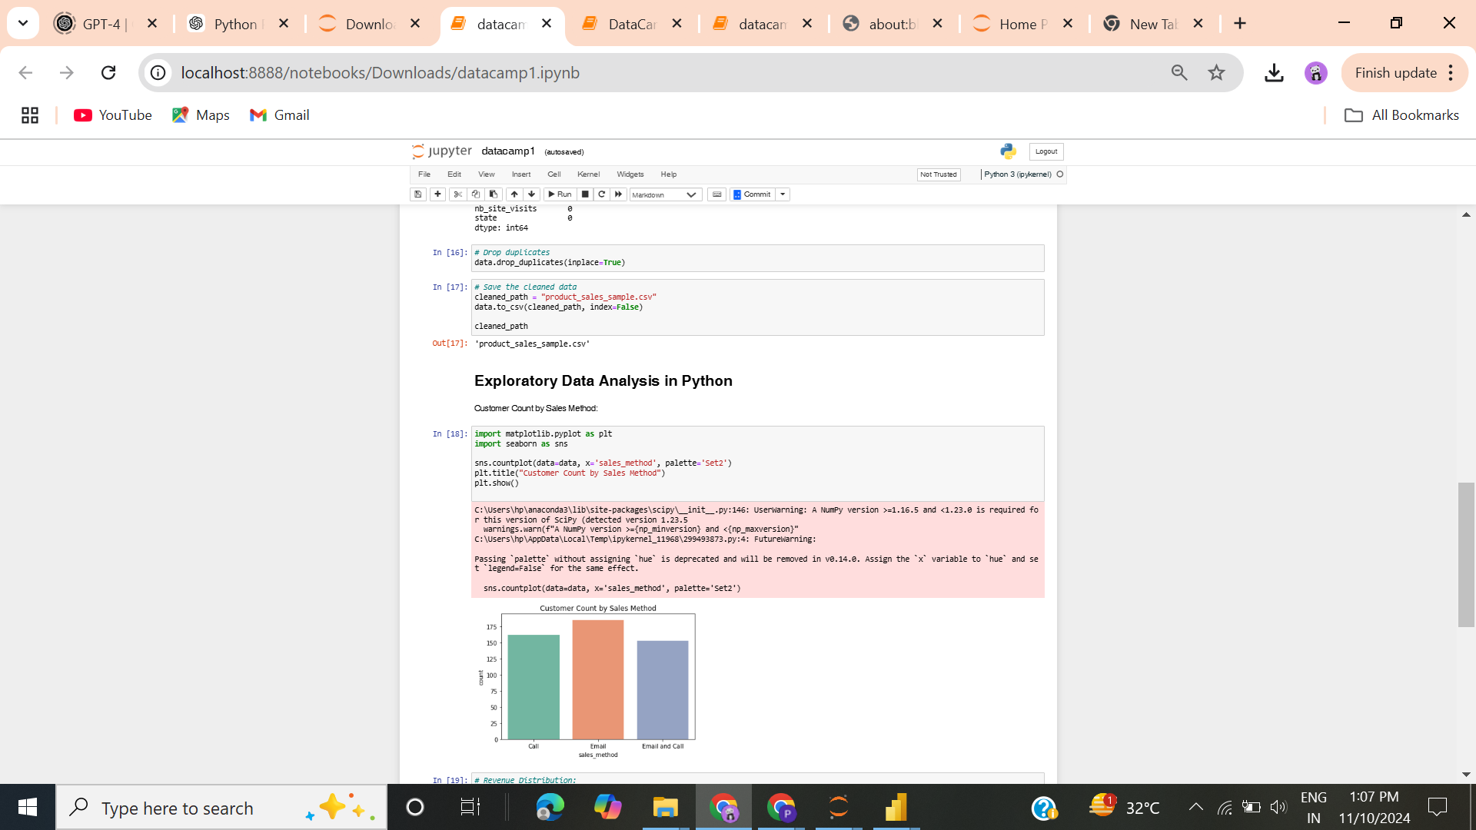
Sales Product Case Study

